Slide 1
The Role of AI in DevOps
Presented by Travis Frisinger
Notes:
Welcome, everyone. Today, we're embarking on an exploration into the transformative power of AI in the realm of DevOps. As we delve into this journey, we'll uncover how AI is not merely an adjunct to our current processes but a fundamental force reshaping the landscape of software development and operations. Our focus will be on understanding AI's role as a catalyst that propels us toward enhanced efficiency, speed, and strength in our DevOps practices, truly embodying the notion of making us better, faster, and stronger. The convergence of AI with DevOps marks a pivotal evolution in our ability to deliver software with unprecedented velocity, accuracy, and innovation.

Slide 2
The Broad Impact of AI on Work
Intersection of AI and DevOps
Culture and Support
Ops and Deployment
Testing and Security
Monitoring and Anomaly Detection
Navigating the Future
Agenda
Notes:
Our agenda is structured around a comprehensive exploration of AI's impact across the board, beginning with its broad influence on the workforce. We'll then zoom into the specific intersections where AI meets DevOps, highlighting how it enriches culture, supports operations, enhances testing and security, and redefines monitoring and anomaly detection. Our journey will culminate in a forward-looking discussion on the future trajectory of AI within DevOps, encouraging us to think about the potential integrations in our own practices. This structured exploration is designed to equip us with a deep understanding of AI's transformative potential, guiding us toward leveraging these advancements to redefine the standards of efficiency and innovation in our work.

Slide 3

AI != Magic
1. What is useful to an engineer?
2. What is robust enough to approach or match human levels of trust when using it?
Notes:
Today, we're peeling back the layers of AI, not as a sudden marvel but as a rich, evolving journey. AI's tale begins not in recent years but stretches back to the 20th century, growing from basic symbolic AI to today's sophisticated algorithms. A great book for its history is “Artificial Intelligence: A Guide for Thinking Humans” by Melanie Mitchell.
The real game-changer came with machine learning, transforming how computers learn from data, shifting from fixed rules to adaptive, learning systems. This evolution set the groundwork for the AI breakthroughs we see today.
Now, we stand at the threshold of a new era with Large Language Models and conversational AI, which are reshaping our understanding of natural language processing. Yet, this isn't just a leap but a step built on decades of progress.
As we explore AI in DevOps, we aim for a balance, leveraging AI's transformative power while staying grounded in its true capabilities. Our journey is about embracing AI's full spectrum, from its historical roots to its future potential.
Thank you for joining this exploration.
Let's dive into the world of AI with open minds, ready to appreciate its depth, complexity, and the promise it holds for the future.

Slide 4
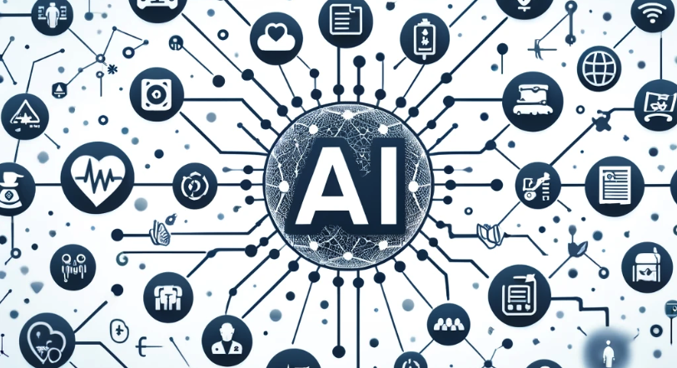
The Broad Impact of AI on Work
AI revolution is not confined to just Tech companies.
Notes:
As we begin our journey, it's crucial to first appreciate the wide-ranging impact of AI beyond the confines of tech industries. AI's transformative effects are felt across various sectors, setting the stage for its significant role in DevOps. From smart assistants in our homes to sophisticated algorithms predicting consumer behavior, AI's capabilities are revolutionizing the way we work, automate processes, and make decisions. This broad impact of AI is a precursor to understanding its specific contributions to DevOps, where it enhances automation, improves decision-making, and fosters innovation, setting a new paradigm for operational excellence and speed.

Slide 5

The Broad Impact of AI on Work
Healthcare
Notes:
In the healthcare sector, AI's capabilities to enhance early disease detection and personalize patient care stand out as quintessential examples of its transformative power. AI algorithms, through advanced data analysis, have the ability to parse through medical imaging with a precision that rivals, and sometimes surpasses, human experts. This not only speeds up the diagnostic process but significantly improves the accuracy of early disease detection, which is critical for successful treatment outcomes. Beyond diagnostics, AI in healthcare extends to patient care management, where it personalizes treatment plans based on individual patient data, improving the quality of care and patient satisfaction. These examples from healthcare illuminate AI's potential to augment human capabilities, making processes more efficient and outcomes more effective—principles directly applicable to enhancing DevOps practices.

Slide 6
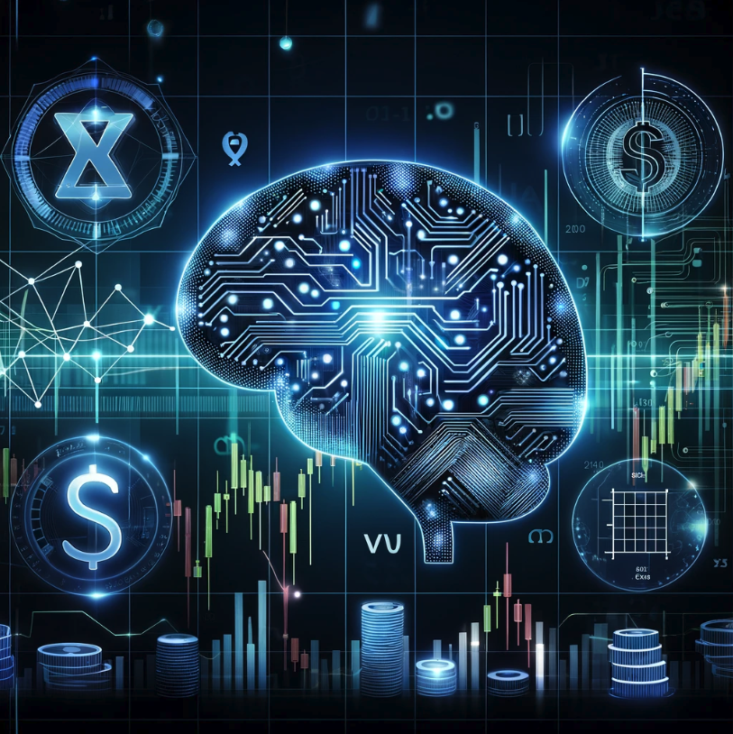
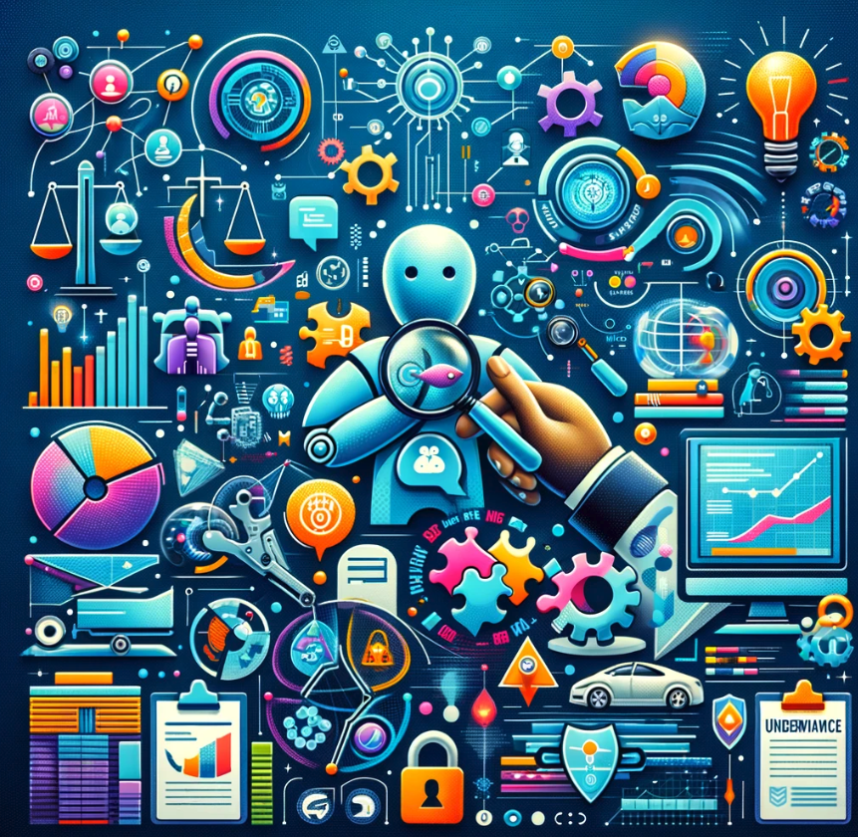
The Broad Impact of AI on Work
Insurance
Notes:
In the insurance industry, AI is revolutionizing how policies are personalized, claims are processed, and fraud is detected. Companies like Lemonade have harnessed AI to assess risk and customize insurance policies with unprecedented accuracy, tailoring coverage to fit individual needs while optimizing pricing. Furthermore, AI's role in streamlining the claims process—reducing it from days to mere seconds—exemplifies efficiency and customer satisfaction. Additionally, AI's ability to analyze patterns and detect anomalies plays a crucial role in combating insurance fraud, ensuring fairness and keeping premiums reasonable for all policyholders. These advancements in insurance highlight AI's capacity to transform traditional processes, making them faster, more personalized, and secure—a testament to the potential of AI to similarly transform DevOps practices by enhancing efficiency, security, and user satisfaction.

Slide 7

The Broad Impact of AI on Work
Manufacturing
Notes:
In manufacturing, AI has ushered in a new era of efficiency and predictive maintenance. Consider how AI algorithms predict when machines are likely to fail, allowing for preemptive maintenance, reducing downtime, and saving costs. This precision in predicting and averting failures exemplifies AI's potential to enhance decision-making and operational efficiency. In DevOps, similar AI applications can predict system vulnerabilities or optimize resource allocation, ensuring our development pipelines are not just faster and more efficient but also more robust and secure. By learning from AI's impact in manufacturing, we can envision a DevOps environment where predictive insights and efficiency drive us towards excellence.

Slide 8
?
The Broad Impact of AI on Work
Notes:
The narrative across healthcare, insurance, and manufacturing reveals a common thread: AI's capacity to enhance precision, efficiency, and foresight. This capacity is equally transformative within DevOps. AI's ability to foresee deployment challenges, optimize workflows, and secure operations parallels its predictive prowess in other sectors. It's about leveraging AI to not just react swiftly but to anticipate and mitigate risks proactively. This forward-thinking approach is crucial in DevOps, ensuring our systems are resilient, our deployments are smooth, and our security posture is robust. AI empowers us to navigate complexity with insight, making our DevOps practices not just reactive but truly proactive and strategic.

Slide 9
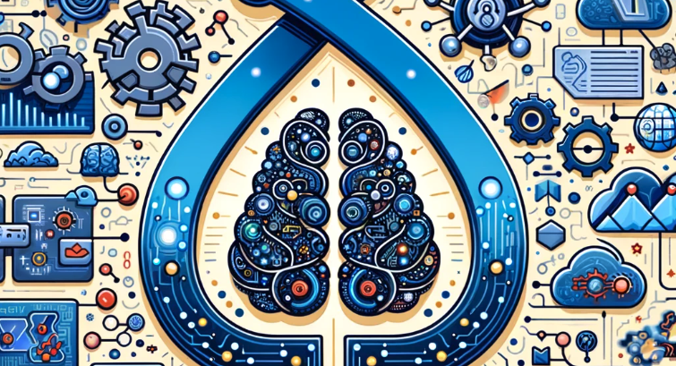
Intersection of AI and DevOps - Culture and Support
Self Service
Notes:
AI's integration into DevOps is profoundly reshaping the cultural and operational fabric of tech organizations. It fosters a collaborative and continuously learning environment, where generative AI-driven tools specifically designed for DevOps tasks such as infrastructure deployment, metrics monitoring, and more, facilitate seamless communication and efficient problem-solving across teams. This evolution enhances not only the pace of decision-making but also ingrains a culture of innovation, making teams more unified, agile, and responsive.
Tools & Examples:
Slack with Generative AI-Driven Chat Bots:
ChatOps Bot for Cloud Deployment: An AI-driven bot that understands natural language commands to deploy infrastructure on cloud platforms like AWS, Azure, or GCP directly from Slack, streamlining deployment processes.
MetricsBot: Offers real-time metrics and alerts on system performance within Slack. By asking MetricsBot, teams can instantly retrieve CPU usage, memory stats, or even detailed performance metrics of specific services.
Incident Management Bot: Uses AI to initiate, manage, and resolve incidents directly within Slack. It can parse natural language to create tickets, escalate issues, and provide status updates, significantly reducing response times during critical operations.
Trends:
AI-Driven Operational Efficiency: The integration of generative AI into DevOps tools is setting a new standard for operational efficiency, transforming how teams deploy infrastructure, monitor metrics, and manage incidents.
Shift to AI-Enhanced Collaborative Environments: The move towards environments where developers, operations, and security professionals use AI-driven tools for better communication and collaboration, fostering a culture of continuous improvement and innovation.
Benefits:
Streamlined Deployment and Monitoring: Generative AI chat bots like the Cloud Deployment Bot and MetricsBot automate and simplify complex tasks, allowing for more efficient and error-free operations.
Enhanced Problem-Solving and Incident Management: AI-driven incident management tools reduce downtime by swiftly addressing and resolving issues, improving system reliability and performance.
Continuous Learning and Adaptation: The use of AI in collaboration tools promotes an environment where teams are constantly exposed to the latest in technology and best practices, driving forward innovation and efficiency within the organization.
By leveraging generative AI within DevOps, we're not just enhancing our toolset but are revolutionizing the way our teams interact, problem-solve, and evolve, laying the groundwork for more resilient and adaptive operations.

Slide 10

Intersection of AI and DevOps - Operations and Deployment
Predictive Maintenance
Notes:
In the realm of DevOps, AI emerges not merely as a catalyst but as a transformative force, propelling operations into a new era of efficiency and intelligence. The adoption of AI-driven tools like Jenkins, GitLab, GitHub Copilot, and others are revolutionizing the way we approach software development and deployment.
Tools and Innovations:
Jenkins & GitLab: These CI/CD platforms are evolving with AI functionalities to predict failures and automate pipeline optimizations, setting a precedent for intelligent automation in continuous integration and deployment.
GitHub Copilot: Powered by OpenAI, it acts as an AI pair programmer, suggesting code snippets and functions to streamline development workflows.
CodeRabbit.ai: Enhances code review processes with AI-powered insights, improving code quality and developer productivity by identifying potential issues and optimization opportunities early in the development cycle.
JFrog Artifactory & Xray: Utilize AI for artifact management and security scanning, ensuring safe, efficient handling of binaries and dependencies, and enhancing vulnerability detection.
Trends:
The shift towards 'Intelligent DevOps' signifies a broader adoption of predictive analytics and AI across development platforms, aiming to predict issues, personalize development experiences, and automate routine tasks.
Real-World Applications and Benefits:
Netflix: Implements AI for optimizing content delivery networks and enhancing recommendation algorithms, leading to significant improvements in user engagement and operational efficiency.
Google: Applies AI in predictive maintenance to preemptively address data center issues, reducing downtime and operational costs.
IBM: Leverages AI for automating software testing processes, thereby accelerating development cycles and elevating software quality.
Spotify: Uses AI to drive feature development and personalize user experiences, optimizing music recommendations and enhancing user satisfaction.
Salesforce: Integrates AI into its development process for smarter customer relationship management solutions, automating tasks and providing predictive insights to serve customers better.
Benefits:
These AI-enhanced tools and practices result in considerable reductions in manual overhead, enabling faster time-to-market, superior code quality, and agile responses to market demands.
Companies leveraging AI in DevOps report significant cost savings, improved operational efficiencies, and heightened software quality, underscoring the value AI brings to software development and operations.
By integrating AI into DevOps, organizations are not only boosting productivity but are also paving the way for more robust, innovative software solutions that cater to the dynamic needs of users and industries.

Slide 11

Intersection of AI and DevOps - Testing and Security
No Longer a Luxury AI’s Role in Testing Code Enhanced Security Posture
Notes:
AI's integration into testing and security is reshaping traditional methods into proactive, intelligence-driven processes. Tools like Snyk, Aqua Security Trivy, and Checkmarx stand at the forefront, offering sophisticated solutions that seamlessly integrate into DevOps workflows, elevating the security and efficiency of development pipelines. Through the power of AI, these tools are setting new standards in vulnerability detection and automated testing, showcasing the pivotal role AI plays in enhancing the security posture and testing processes within DevOps.
Tools:
Snyk: Harnesses machine learning to seamlessly identify and prioritize vulnerabilities in dependencies, ensuring security is an integral part of the DevOps workflow.
Aqua Security Trivy: Provides comprehensive security scanning with AI-enhanced capabilities, enabling robust vulnerability detection in containers, infrastructure as code (IaC), and more.
Checkmarx: Leverages AI to conduct static and dynamic code analysis, pinpointing security vulnerabilities and coding flaws with unprecedented accuracy and efficiency.
Trends:
Integration of AI in Security Tools: Observing a surge in AI and machine learning technologies being embedded within security tools, revolutionizing how vulnerabilities are predicted, identified, and mitigated.
AI-Driven Automated Testing: The shift towards leveraging AI for automating test case generation and execution, enhancing test coverage and efficiency, reflects the growing reliance on AI within DevOps practices.
Benefits:
Enhanced Security Posture: AI-enabled tools provide proactive detection and remediation capabilities, significantly diminishing the risk of security breaches and vulnerabilities.
Improved Testing Efficiency: The automation of test generation and execution, facilitated by AI, accelerates the testing process, enabling more frequent and reliable releases.
Increased Accuracy in Vulnerability Detection: The application of AI in analyzing vast datasets improves the accuracy of identifying vulnerabilities and defects, minimizing false positives and allowing teams to focus on genuine security concerns.
In essence, the integration of AI into testing and security within DevOps is not just enhancing existing protocols but is actively redefining them, offering a more resilient, efficient, and secure framework for modern software development.

Slide 12
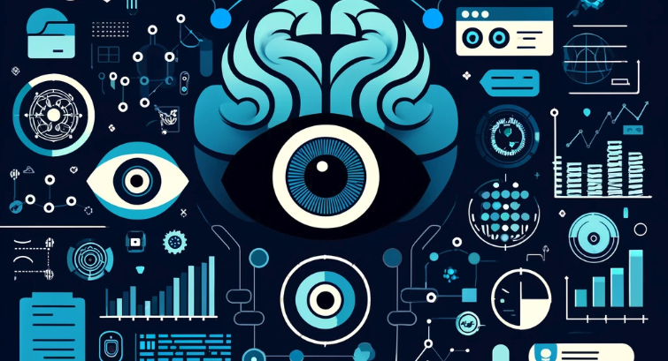
Intersection of AI and DevOps - Monitoring and Anomaly Detection
Predictive Monitoring
Notes:
As we explore the critical role of AI in DevOps, focusing on monitoring and anomaly detection, the innovative capabilities of leading platforms stand out prominently:
Tools:
Datadog: Employs AI for comprehensive monitoring across applications, networks, and infrastructure, facilitating anomaly detection and predictive analytics.
New Relic: Delivers AI-powered insights for application performance monitoring, enabling teams to proactively address issues before they escalate.
Splunk: Leverages machine learning to provide operational intelligence, significantly improving anomaly detection, prediction, and prevention.
Trends:
AI-Driven Anomaly Detection: There's a growing trend towards utilizing AI for real-time identification and alerting of irregular patterns, drastically minimizing downtime and improving system reliability.
Predictive Operational Insights: AI is increasingly used to anticipate system issues, allowing for proactive maintenance and system optimization, leading to more resilient and efficient operations.
Benefits:
Proactive Issue Resolution: AI-powered monitoring tools proactively identify and resolve problems, ensuring uninterrupted operations and enhancing user experience.
Enhanced System Reliability: Continuous AI-driven analysis and monitoring bolster system performance, significantly reducing the likelihood of outages and errors.
Operational Cost Savings: The predictive capabilities of AI in monitoring and anomaly detection enable organizations to avoid costly downtimes and reduce the need for manual troubleshooting, resulting in substantial operational cost savings.

Slide 13
?
Navigating the Future
Notes:
As we look towards the future, the integration of AI into DevOps, especially through advanced monitoring and anomaly detection, paves the way for a more sophisticated approach to AI operations. The principles we've applied in monitoring and anomaly detection are foundational, setting the stage for the evolution of MLOps and LLM Ops. These emerging disciplines underscore the need for specialized practices to manage the complexities of machine learning and large language models, highlighting the ongoing journey of AI in enhancing DevOps practices. As we explore these future directions, it's clear that AI will continue to be a pivotal force in driving innovation, efficiency, and resilience in DevOps.

Slide 14
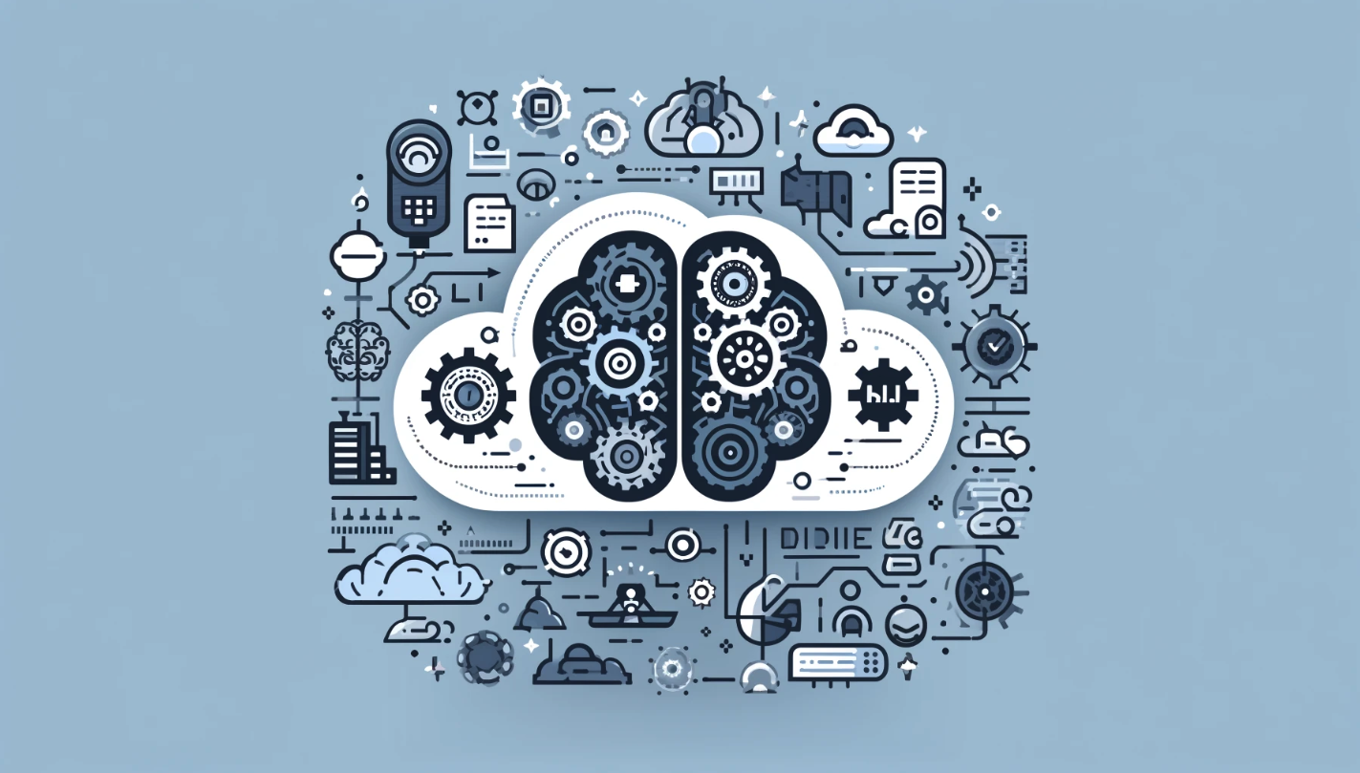
Navigating the Future - MLOps
Model Evaluation Metric
Drift Metrics
Model Fairness
Notes:
MLOps, or Machine Learning Operations, crystallizes at the convergence of machine learning and DevOps, heralding a future where AI-driven applications transition seamlessly from development to deployment. This discipline, essential for the lifecycle management of ML models, ensures not just deployment, but also the continuous evolution, monitoring, and governance of models in production settings.
MLOps Defined: At its core, MLOps is about streamlining and automating the machine learning models' journey to production. It's a collaborative effort involving data scientists, DevOps engineers, and IT, aiming to enhance the creation, quality, and maintenance of AI solutions.
Why MLOps?: The lifecycle of machine learning projects is fraught with complexity—spanning data preparation, model training, deployment, and monitoring. MLOps introduces the operational rigor needed to synchronize these components effectively, facilitating smoother hand-offs across teams and ensuring the models’ reliability and scalability.
Benefits of MLOps:
Efficiency and Speed: Accelerates the pace of model development and deployment, enabling faster iterations and innovations.
Scalability: Facilitates the management and monitoring of vast model portfolios, ensuring consistent performance and governance.
Risk Reduction: Enhances regulatory compliance and model accuracy through continuous monitoring and adaptation to data drift.
MLOps vs. DevOps: While drawing from DevOps' principles, MLOps tailors these for the unique challenges of machine learning projects, emphasizing continuous improvement and integration of models rather than software applications alone.
LLMOps Consideration: Training LLMs, such as Dolly, introduces specific nuances, including the need for specialized computational resources (GPUs), the application of transfer learning, the importance of human feedback, and hyperparameter tuning focused on efficiency and computational optimization.
Components of MLOps:
From exploratory data analysis (EDA) and data prep to model training, review, and governance, MLOps covers the entire ML lifecycle.
It emphasizes reproducibility, collaboration, and automated retraining to adapt to new data and evolving project requirements.
MLOps Platforms: Serve as collaborative environments for iterative data exploration and model management, automating the synchronization of the ML lifecycle and enhancing team co-working capabilities.
In sum, MLOps is not merely a set of practices but a foundational framework that enables AI and machine learning to thrive within the fast-paced, quality-focused world of DevOps. As we navigate towards the future, MLOps stands as a testament to the evolving relationship between AI and operational excellence, ensuring machine learning projects are not only innovative but also robust, scalable, and aligned with organizational goals.

Slide 15

Navigating the Future - LLMOps
Prompt Engineering and Management
Fine Tuning
LLM Hallucination Detection
Notes:
The emergence of LLMOps alongside MLOps marks a transformative step in operationalizing AI, particularly with the deployment and management of Large Language Models (LLMs) such as GPT. LLMOps not only confronts the unique challenges posed by the complexity and scale of LLMs but also seizes the opportunities they offer for innovation across a spectrum of applications.
Deployment Decisions: Build vs. Buy vs. Open Source
Custom Models: Building an LLM from scratch affords full control over data privacy and model specifications, potentially offering competitive advantages through bespoke features and optimized performance.
Commercial Models: Leveraging models like GPT-4 can significantly reduce upfront costs and technical barriers, facilitating rapid prototyping and deployment.
Open Source Models: Open source LLMs, such as Alpaca and LLaMa, provide a middle ground, offering powerful capabilities with greater flexibility over deployment and customization.
Optimizing LLM Performance
Prompt Engineering: A critical step in deploying LLMs, where the craft of creating effective prompts can significantly influence model performance and output quality.
Fine Tuning: Adapting a model to specific tasks or domains by training on a targeted dataset, enhancing its responsiveness to particular use cases.
Context Retrieval: Enhancing LLM responses by supplementing model input with relevant external context, thereby improving accuracy and relevance.
Operational Considerations
Latency and Cost: Assessing the trade-offs between response times and operational expenses, with choices around hardware and model size impacting both.
Resource Management: Strategies for hosting, managing, and optimizing the computational resources required for LLM deployment.
Security and Privacy: Ensuring data protection and compliance with regulatory requirements throughout the model's lifecycle.
Post-Launch Strategies
Continuous monitoring of model performance and resource utilization is vital for maintaining efficiency and addressing any emerging challenges or opportunities for optimization.
Engagement with open source and commercial developments in the LLM space can provide ongoing insights and opportunities for enhancement.
LLMOps embodies a comprehensive approach to harnessing the power of LLMs within DevOps, emphasizing not just the technical deployment but also the ethical, operational, and strategic dimensions of using such advanced AI tools. As we advance, the integration of LLMs into our technological toolkit demands a nuanced understanding of their capabilities, limitations, and impact on the broader ecosystem.

Slide 16

Notes:
As we draw this exploration to a close, reflecting on the journey from the integration of AI and DevOps to the cutting-edge realms of ML Ops and LLM Ops, it's clear we stand at a transformative juncture in technology. These discussions illuminate not just the potential of artificial intelligence to revolutionize how we develop, deploy, and manage software, but also the evolving challenges and responsibilities that come with it.
We've ventured through the synergies between AI and DevOps, witnessing how they streamline operations, enhance collaboration, and push the boundaries of innovation. The introduction of ML Ops and LLM Ops has opened our eyes to the specialized disciplines emerging to navigate the complexities of machine learning and large language models in production environments.
As we look to the future, the landscape of technology is ripe with opportunity and challenge. The principles of DevOps, enriched by AI, offer a blueprint for progress, emphasizing agility, efficiency, and continuous improvement. Yet, as we advance, it's imperative that we navigate this terrain with a keen sense of responsibility—toward not only the integrity and reliability of our systems but also the ethical implications of the technologies we deploy.
In closing, let's embrace this era of technological advancement with enthusiasm and caution, striving to leverage AI and DevOps not just for operational excellence but also as a force for good. May the insights from today inspire you to pioneer solutions that not only elevate your organization but also contribute positively to the sectors that touch our lives daily.

Slide 17

https://linktr.ee/tmfrisinger
Notes:
Thank you for joining in this exploration.

Slide 18
https://cloud.folio3.com/blog/generative-ai-in-devops/
https://about.gitlab.com/topics/devops/the-role-of-ai-in-devops/
https://devops.com/how-ai-addresses-devops-monitoring-and-observability-challenges/
https://devops.com/logz-io-leverages-ai-to-identify-anomalies-in-real-time/
https://www.techtarget.com/searchitoperations/tip/Generative-AI-use-cases-for-DevOps-and-IT
https://clickup.com/blog/ai-tools-for-devops/
https://www.xenonstack.com/insights/ai-in-devops
Sources

